Slide 1
ICP Presentation -2
Presentation on Android Apps
Team:
Venu Linga
Sarath Chandra Kunisetty

Slide 2
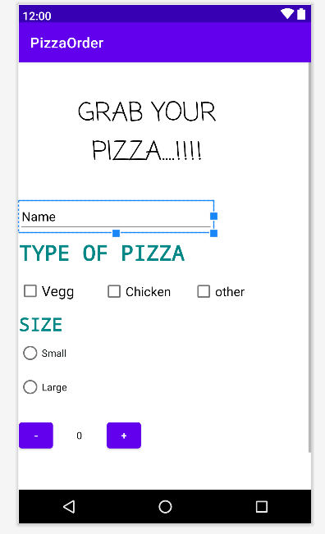
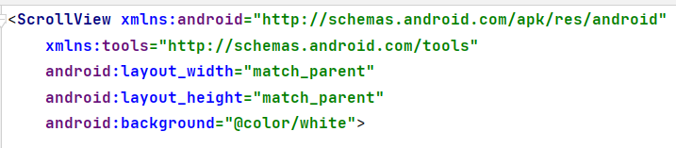
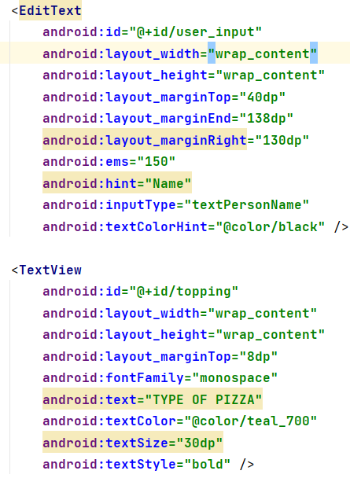
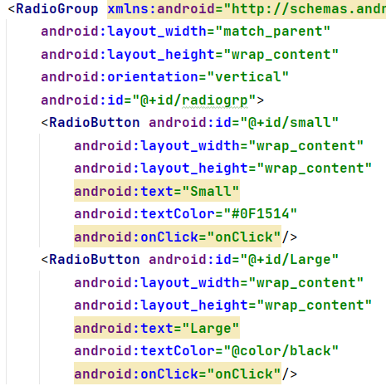
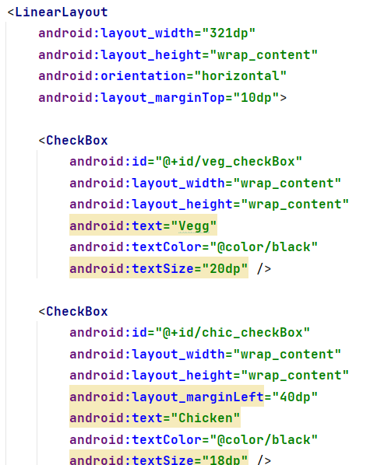
ICP -9
In This ICP we have created the simple Pizza order app, added mail notification with summary after the order.
Here we have used text view, Edit text, Check Box, Radio View in respective linear layouts and all the elements in the Scroll View.

Slide 3
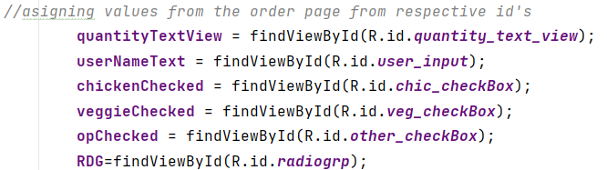
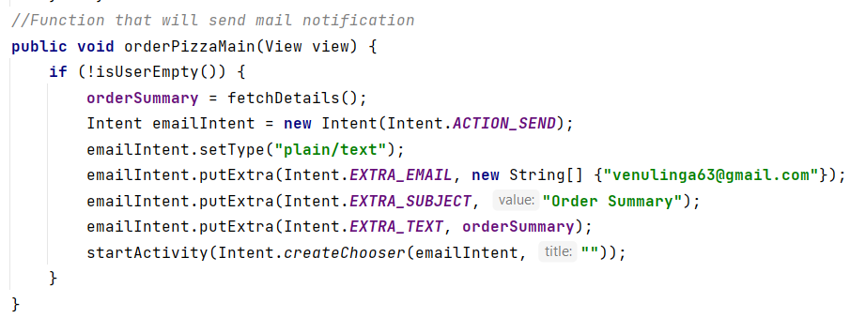
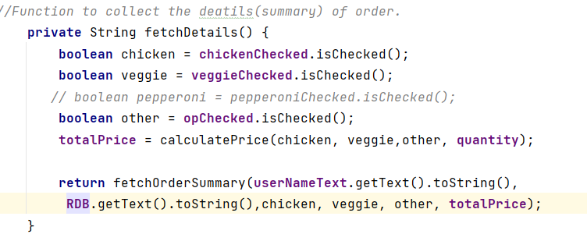
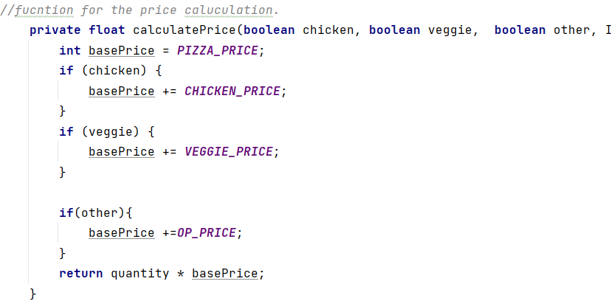
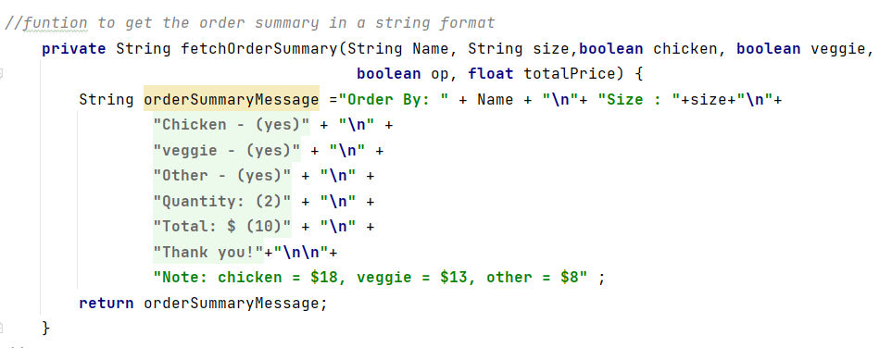

Slide 4
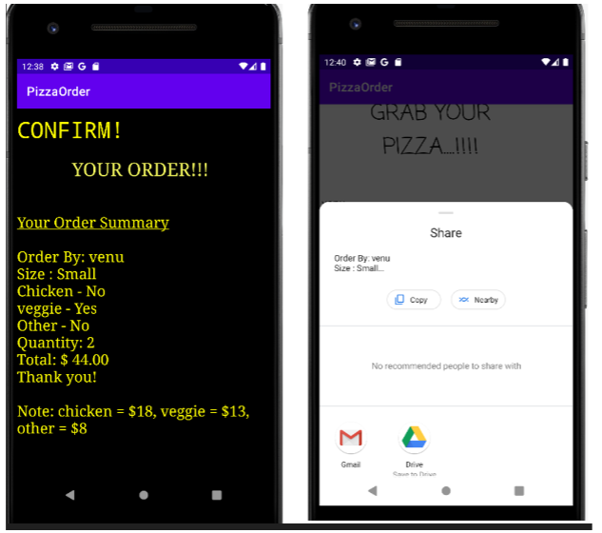
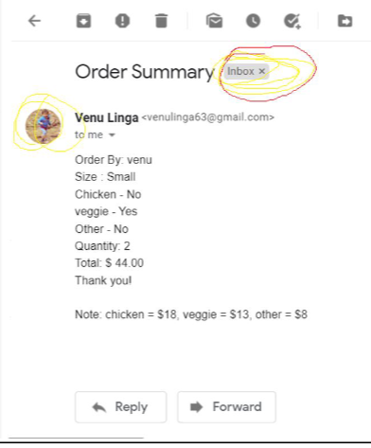
We do include the buttons summary and order, the summary button click will shows the details of our order include type, quantity an price.
The order button will call the OrderPizzaMenu function and sends mail with order details.

Slide 5
ICP 11
Text-To-Speech:
Text to speech is a android library which is used to synthesize a voice playback for the user’s text input. This library gives us an option of enabling the voice playback in various languages. It is also known as “Speech Synthesis”. There are various methods available in this library some of them are:
setPitch(float pitch)
setSpeechRate(float speechRate)
setLanguage(Locale loc)
setVoice(Voice voice)
Text-To-Speech is widely used in various real time situations like Audio Books, Businesses with visually challenged customers etc.

Slide 6
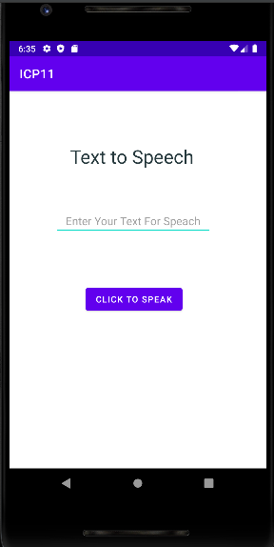
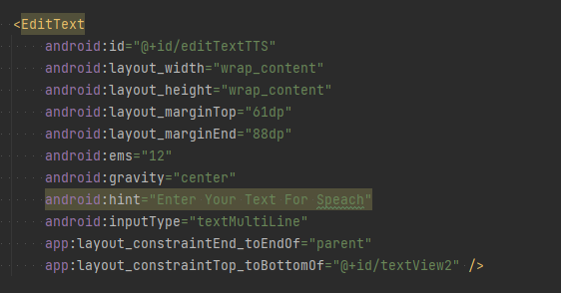
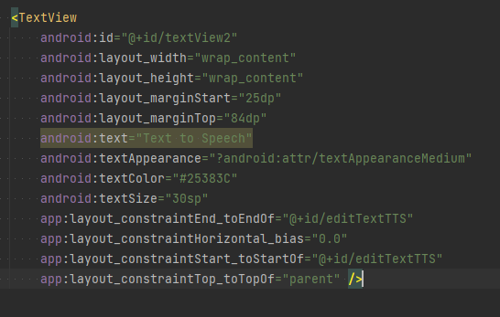
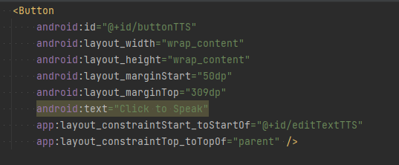
Implementation:
Necessary elements (EditText, Button, TextView) and their required styling like size, font etc., was added in the activity_main.xml file

Slide 7
Implementation (cont’d) :
The logical/code implementation was added in the “MainActivity.java” file in the “onCreate()” method. In this method 3 variable instances was created for the 3 UI elements by using the ID.
The TTS(Text-To-Speech) will be activated once the user clicks on the “Click to Speak” button. So an event listener was added to that button “setOnClickListener()” which triggers the “onClick()” method once user clicks on the button in which TextToSpeech is implemented.
A new object is created for the TextToSpeech class while implementing OnInit() method. Here we are setting the language as US and verifying whether the user’s input as per the requirement and if it is then the “speak()” is invoked.
In “speak()” method the user input is stored into the string s, where it is validated if the users input is valid or not. If it is valid then the TalkToSpeech’s “speak()” is invoked with the user’s input passed as a parameter. If the user’s is invalid then a voice play back is initiated prompting the user to input something into the field.
“onPause()” method was implemented inorder to stop the voice playback once the app is returned to background activity and “onDestroy()” method is implemented inorder to shutdown the TextToSpeach service so that other resources will be able to utilize this functionality.

Slide 8
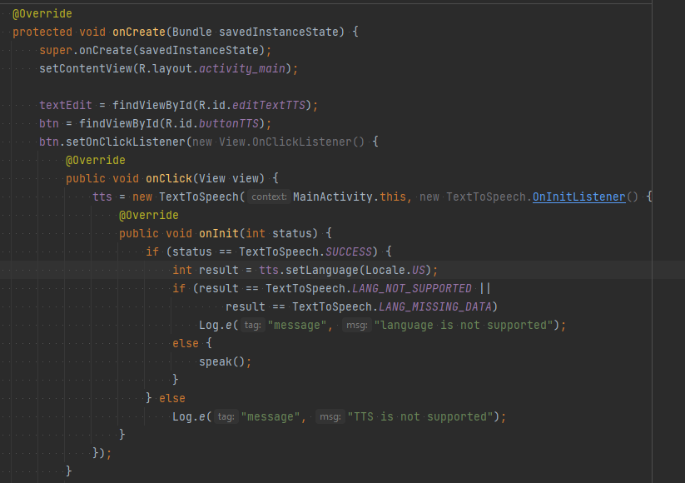
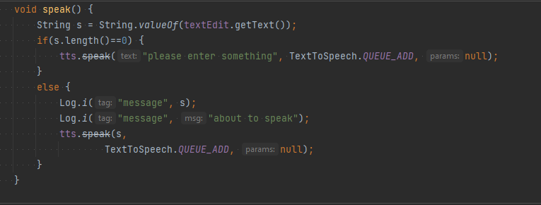
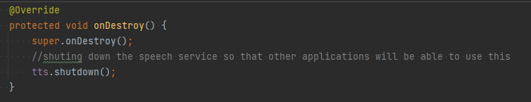
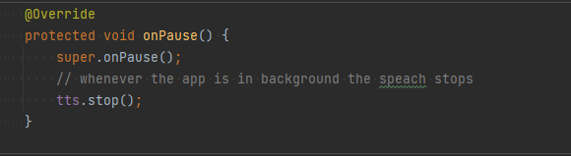
Implementation (cont’d) :

Slide 9
Conclusion:
From the ICP 9 we gained knowledge on the sending Email notification in android, and also elements the scroll down view. Calling functions directly from the button click.
Through ICP11 we were able to gain good knowledge about how to utilize Text-To-Speech functionality with different methods available in an android application.

Slide 10
THANK YOU

